Slide 1


AstroSage Analysis
Presented By
Gagan

Slide 2

Problem Statement
The task is to optimize the call center operations for AstroSage, which has received a 1 crore investment. The goal is to determine how to allocate this investment to maximize operational efficiency, customer satisfaction, and profitability with relevant insights from the operational data. This project will involve analyzing historical call data, performance metrics, and market trends to make informed decisions.

Slide 3
Data Overview
_id: Unique identifier for each record.
user: User ID associated with the record.
chatStatus: Status of the chat (e.g., incomplete, failed, completed).
guru: Unique identifier for the guru.
guruName: Name of the guru.
gid: Guru ID.
uid: User ID.
consultation Type: Type of consultation (e.g., Chat, Call).
website: Source of the consultation (e.g., gurucool).
Refund Status: Indicates if the session is refundable or not (e.g., no-refund).
is WhiteList User: Boolean indicating if the user is whitelisted.
chat Seconds: Duration of the chat in seconds.
queue: Boolean indicating if the session was queued.
FreeCall: Boolean indicating if the call was free.
Free Chat: Boolean indicating if the chat was free.
CreatedAT: Original creation date and time.
updatedAt: Original update date and time.
__v: Version key.

Slide 4
Data Overview
statementEntryId: Identifier for the statement entry.
chatStartTime: Start time of the chat.
chatEndTime: End time of the chat.
timeDuration: Undefined, some technical data as per app. (Don’t use it as the duration of chat/call)
callChannel: Channel used for the call.
calIvrType: IVR type used during the call.
callStatus: Status of the call.
CallSid: Unique identifier for the call session.
amount: Amount charged for the session.
astrologerCallStatus: Status of the astrologer during the call.
astrologerOnCallDuration: Duration of the astrologer's call.
astrologersEarnings: Earnings of the astrologer from the session.
netAmount: Net amount after deductions.
region: Region of the user.
userCallStatus: Status of the user's call.
userOnCallDuration: Duration of the user's call.
rating: Rating assigned based on the session's status.

Slide 5

Transforming Call Center Operations: A Strategic Investment Approach
Leveraging Data and Technology for Enhanced Performance and Customer Satisfaction

Slide 6

Optimizing AstroSage Call Center Operations with ₹1 Crore Investment
Investment Overview
Analytical Approach
AstroSage has secured a ₹1 crore investment aimed at enhancing its call center operations.
This funding is dedicated to improving efficiency, customer satisfaction, and profitability.
The presentation includes a detailed analysis of historical call data and key performance metrics.
Market trends are also examined to provide a comprehensive understanding of operational dynamics.
Strategic Allocation
Data-Driven Insights
Recommendations are made for the strategic allocation of funds to maximize operational efficiency.
These strategies aim to elevate customer satisfaction and drive profitability.
Insights are derived from cleaned and consolidated data to ensure informed decision-making.
This approach supports sustainable growth and operational improvements.

Slide 7

Comprehensive Overview of AstroSage Call Center Data
Data Structure Overview
Data Cleaning Process
The data is organized into a single consolidated table.
This table contains 30 refined columns after rigorous cleaning processes.
Missing values were addressed and duplicates removed.
Text formats were standardized and derived columns created for enhanced accuracy.
Key Metrics Analysis
Repeat Callers Insights
The total calls, excluding Public_Live_Call, amount to 8,508.
Average daily call volume is calculated at 250.24 calls.
There are 1,275 repeat callers.
This represents 56.63% of the total calls handled.
Data Quality Assurance
Consistency and reliability of the data were ensured.
This supports robust analysis and actionable insights into call center performance.

Slide 8





Critical Performance Metrics and Operational Insights
2.25
₹214,065.90
-0.0002
40.43%
72.51%
Average Calls Handled
Per Agent Per Day
Total Sales Generated
Correlation Between Call Duration and Customer Satisfaction
Call Completion Rate
High Proportion of Low Satisfaction Scores
Indicating moderate agent workload.
Across product categories.
Suggesting call length does not directly impact satisfaction.
Only 3,453 of 8,541 calls successfully completed, highlighting a significant performance gap.
Ratings between 0 to 4 signal quality concerns.

Slide 9
Analysis on Daily Call volumes
Daily call volumes have been declining gradually which could be identified from the trendline.
Calls being the major contributor to revenue, declining in call volume exponentially affect the revenue.
One of the Major reason for this would be the percentage of failed/ incomplete calls which contributes to 59% of total call volumes.

Slide 10
Investment Options: Risks and Mitigation Strategies
Hiring More Agents
Improving Training Programs
Risks: High turnover, compromised recruit quality, increased operational expenses.
Mitigation: Skill-based recruitment, retention incentives, flexible staffing models.
Each option presents unique challenges; strategic mitigation ensures investment effectiveness and operational stability.
Risks: Costly development, uncertain impact, resistance to change.
Mitigation: Pilot testing, blended learning approaches, employee involvement in design.
Each option presents unique challenges; strategic mitigation ensures investment effectiveness and operational stability.

Slide 11
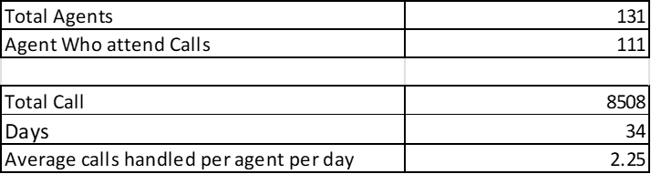
Average calls handled by agents per day
The Top 10 agents by handling calls is being generated by this pivot table
The average calls handled by an agent in a day is 2.25..
Formula used:
(Total calls)/(Agents who attend Calls)*(Days)
The Top gurus have been overloaded with extreme number of calls and the bottom gurus have been handling very a smaller number of calls depicting poor call distribution.
Call distribution to be optimized by using better marketing techniques for better call facility to the customers.

Slide 12
Call Center Workload Management
Balanced Workload Distribution
Rotating Shifts and Call Caps
Prevents burnout and maintains consistency
Distributes workload evenly
2
3
Optimal Agent Performance
Data Analysis Tools
Ensures high service quality and agent well-being
1
4
Identifies workload disparities

Slide 13
CALLS PER HOURS
As we can see on Peak hours 5 AM to 4 PM we have the Highest Call Volume. Only 40.43%
(completed call / total call) *100] of users got service and rest is seen as they didn’t get any
services. For Improvement -
Shift-Based Staffing: Implement scheduled shifts to ensure consistent service availability and reduce agent fatigue.
Callback System: Allow users to request callbacks during high-traffic times, improving customer convenience and reducing wait times.
Auto-Replies & Chatbots: Use automated responses and AI-driven chatbots to handle basic queries instantly and reduce response delays.

Slide 14
Revenue Generated by Category Consultation Type
Observations:
Call consultations contribute ~78.7% of total revenue (₹1,68,520.62), indicating user preference.
Chat consultations generate ~21.3% (₹45,495), showing moderate adoption.
No revenue from 'Others' category (or data not available), suggesting either low engagement or non-utilization.
Recommendations:
Prioritize Call services: Maintain quality and capacity to meet demand.
Promote Chat consultations: Use offers or faster response as incentives to boost usage.
Explore 'Others' category (if applicable): Evaluate viability or repurpose the slot for emerging services.

Slide 15
Consultation Type by Users
Since 69.62% of total users prefer the chat service, and 100% of high satisfaction scores come from chat users, it is evident that the chat service is a key contributor to customer satisfaction.
High Chat Usage: 69.62% of users depend on the chat service, showing its critical role.
Single Provider: Gurucool is the only platform offering this feature.
Low User Satisfaction: Average rating of 2.71 indicates dissatisfaction.
Recommendation for Improvement: To further enhance user experience and overall performance, the company should:
Need for Upgrade: Tech improvements are essential to enhance user experience and retention.
Growth Potential: Despite risks, upgrades can boost engagement and overall performance
Introduce AI-powered chatbots to handle routine queries efficiently.
Train employees to adopt new tools, technologies, and processes that support scalability and quality service.

Slide 16
Guru Distribution by Rating
Only 27.49% of users are satisfied with the service.
Total users = 28027
Satisfied user (Rating-5,6,7,8) = 27.49 %
Unsatisfied user (Rating-0,1,2,3,4) = 72.51 %
Pivot Tables Show the detail and Rating (0to4) = 72.51% (20323)
Rating (5to8) = 27.49% (7704). It shows the low satisfaction scores.
The Investment should be used to improve training program
Recommendation -
Efficient Call Handling: Train astrologers to manage calls effectively, reducing duration without affecting service quality.
Skill Enhancement: Improve employee communication and service skills for better customer interactions.
Scalability Support: Prepare staff to adapt to new tools and processes as the service expands.

Slide 17
Enhancing Customer Service Efficiency
Technology Upgrade
Analytics & Monitoring
Tracking performance metrics
Modernizing systems for better call management
Strategic Hiring
Training & Coaching
Adding staff during peak times
Improving agent skills and satisfaction
Automation
Implementing AI and scheduling tools

Slide 18
Proposed Allocation of ₹1 Crore Investment
₹35,00,000
₹25,00,000
₹20,00,000
₹15,00,000
₹5,00,000
Technology Upgrades
Training & Performance Coaching
Automation Implementation
Strategic Hiring
Analytics & Monitoring Systems
Modernize call routing and provide agents with real-time caller insights.
Enhance agent skills, focusing on FCR and customer handling.
Automate routine queries and implement callback systems during peak hours.
Employ part-time/on-demand agents to manage high call volumes cost-effectively.
Deploy real-time dashboards for KPI tracking and timely decision-making.

Slide 19
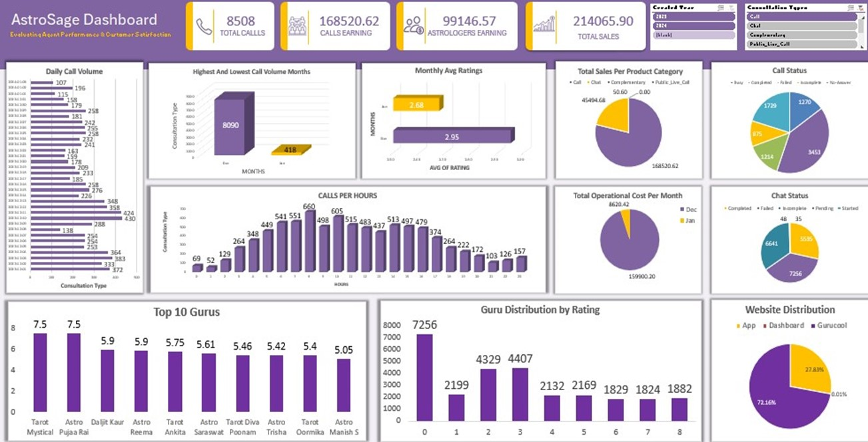
AstroSage Analysis Dashboard

Slide 20
Here is Strategic Allocation Plan for ₹1 Crore Investment: Enhancing Efficiency, Satisfaction & Profitability
1. Technology Upgrade (IVR, CRM) – ₹35,00,000
Modernize IVR and CRM systems for better call routing and faster agent access to caller history.
Reduces dropped calls, wait times, and call misdirection.
Enhances customer experience through personalization and efficiency.
2. Training & Performance Coaching – ₹25,00,000
Focused training modules to improve First Call Resolution (FCR) and customer handling skills.
Regular coaching for low-performing agents and skill refreshers for all.
Directly improves customer satisfaction and agent confidence.
3. Automation (AI bots, Call Scheduling) – ₹20,00,000
Implement AI chatbots for handling FAQs and low-priority queries.
Introduce auto-scheduling and callback systems during peak hours.
Frees up agents for complex calls and ensures faster resolution.

Slide 21
4. Strategic Hiring (Peak-Time Staffing) – ₹15,00,000
Hire trained part-time or on-demand agents for high-traffic periods.
Prevents overload on existing staff, improving quality and morale.
Cost-effective: only add workforce when needed.
5. Analytics & Monitoring Systems – ₹5,00,000
Real-time dashboards and analytics for performance monitoring.
Helps in tracking KPIs like call volume, duration, satisfaction scores.
Enables management to make timely, data-backed decisions.

Slide 22
Conclusion and Strategic Next Steps
Training as a High ROI Investment
Balanced Strategic Approach
Optimizing Resource Allocation
Data analysis reveals training as the highest ROI investment.
This insight underscores the importance of prioritizing training initiatives for optimal returns.
A balanced approach combining technology upgrades, targeted hiring, and enhanced training is essential.
This strategy ensures comprehensive development across key operational areas.
Leveraging chat services and data analytics optimizes resource allocation and customer engagement.
These tools provide actionable insights for improving efficiency and customer satisfaction.
Phased Implementation Plan
Commitment to Excellence
Initiate phased implementation starting with pilot training and technology upgrades.
This step-by-step approach facilitates smooth integration and minimizes disruptions.
Commitment to ongoing improvement will position AstroSage’s call center for operational excellence, superior customer satisfaction, and sustained profitability.
Continuous enhancement ensures long-term success and competitive advantage.

